Slide 1
Digital Portfolio
STUDENT NAME. : Thrisha.R
REGISTER NO AND NMID:
DEPARTMENT. : B.sc(cs with ds)
COLLEGE. : Tagore college of arts and science

Slide 2
PROJECT TITLE
TamilNadu Tourist places
Ooty
Kodaikanal
Mahaballipuram
Madurai
Kaniyakumari

Slide 3


AGENDA
Problem Statement
Project Overview
End Users
Tools and Technologies
Portfolio design and Layout
Features and Functionality
Results and Screenshots
Conclusion
Github Link
3/21/2024 Annual Review

Slide 4

PROBLEM STATEMENT
Tourist often face difficulty in finding reliable information about tourist places in Tamil Nadu.They need single digital platform that provides details, images,and highlights of famous destinations
A digital portfolio can solve this by showcasing Tamil Nadu’s major tourist attractions in a simple and attractive way.

Slide 5
PROJECT OVERVIEW
This project is a Digital portfolio website that highlights popular tourist
Places in Tamil Nadu such as ooty, Kodaikanal, Madurai, Mahaballipuram,
Kanyakumari. The portfolio provides description,image and key details in a
User-friendly format. The aim is to create awareness and guide visitors to
Explore Tamil Nadu’s rich culture and heritage

Slide 6

WHO ARE THE END USERS?
Tourist/Travelers : to plan their trip
Student : for project or study reference.
Local people : to promote tourism.
Travel Agencies : to showcase destination.

Slide 7

TOOLS AND TECHNIQUES
Frontend : HTML,CSS
Images. : Tourist place picture
Editor. : VS code/Notepad++
Hosting : GitHub pages

Slide 8
POTFOLIO DESIGN AND LAYOUT
A simple and responsive design using HTLM and CSS
Home page with an introduction to Tamil Nadu tourism.
Separate sections/ cards for each tourist place with text and image.
Navigation menu for easy access.
8

Slide 9
FEATURES AND FUNCTIONALITY
Tourist places description with images.
Easy-to-read layout and attractive design.
Simple navigation (Home, About, places, Contact.
Responsive structure to view on mobile/laptop.

Slide 10
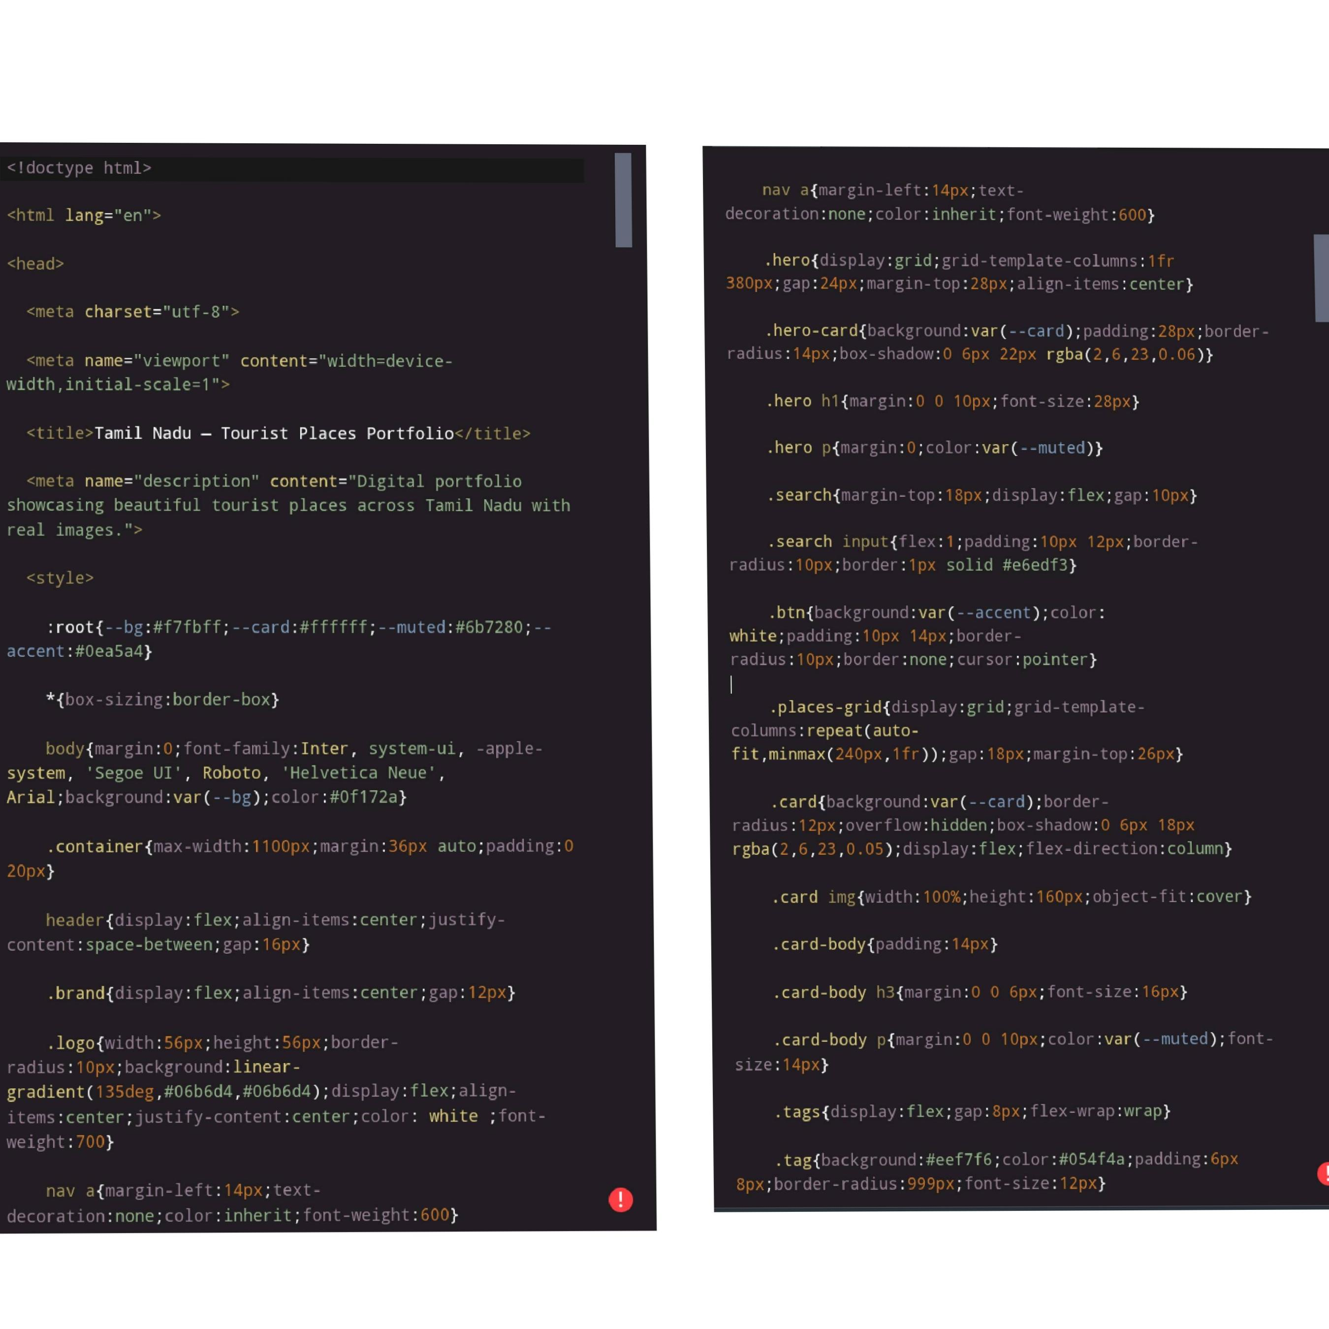

CODING AND SCREENSHOTS
3/21/2024 Annual Review
10

Slide 11
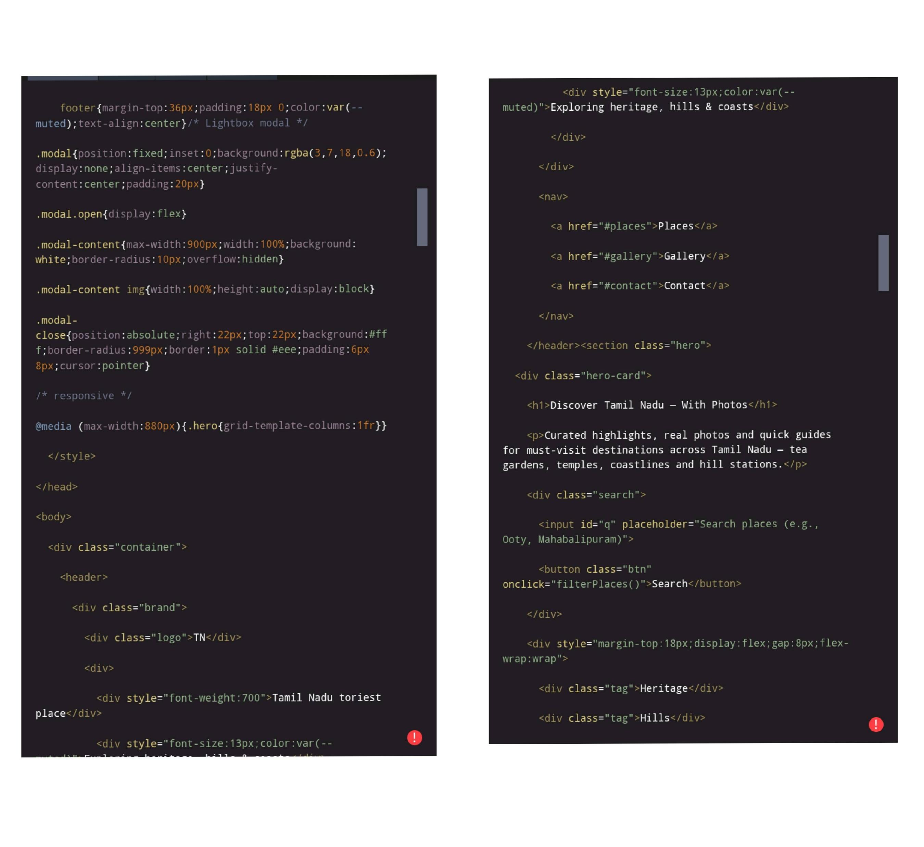

Slide 12
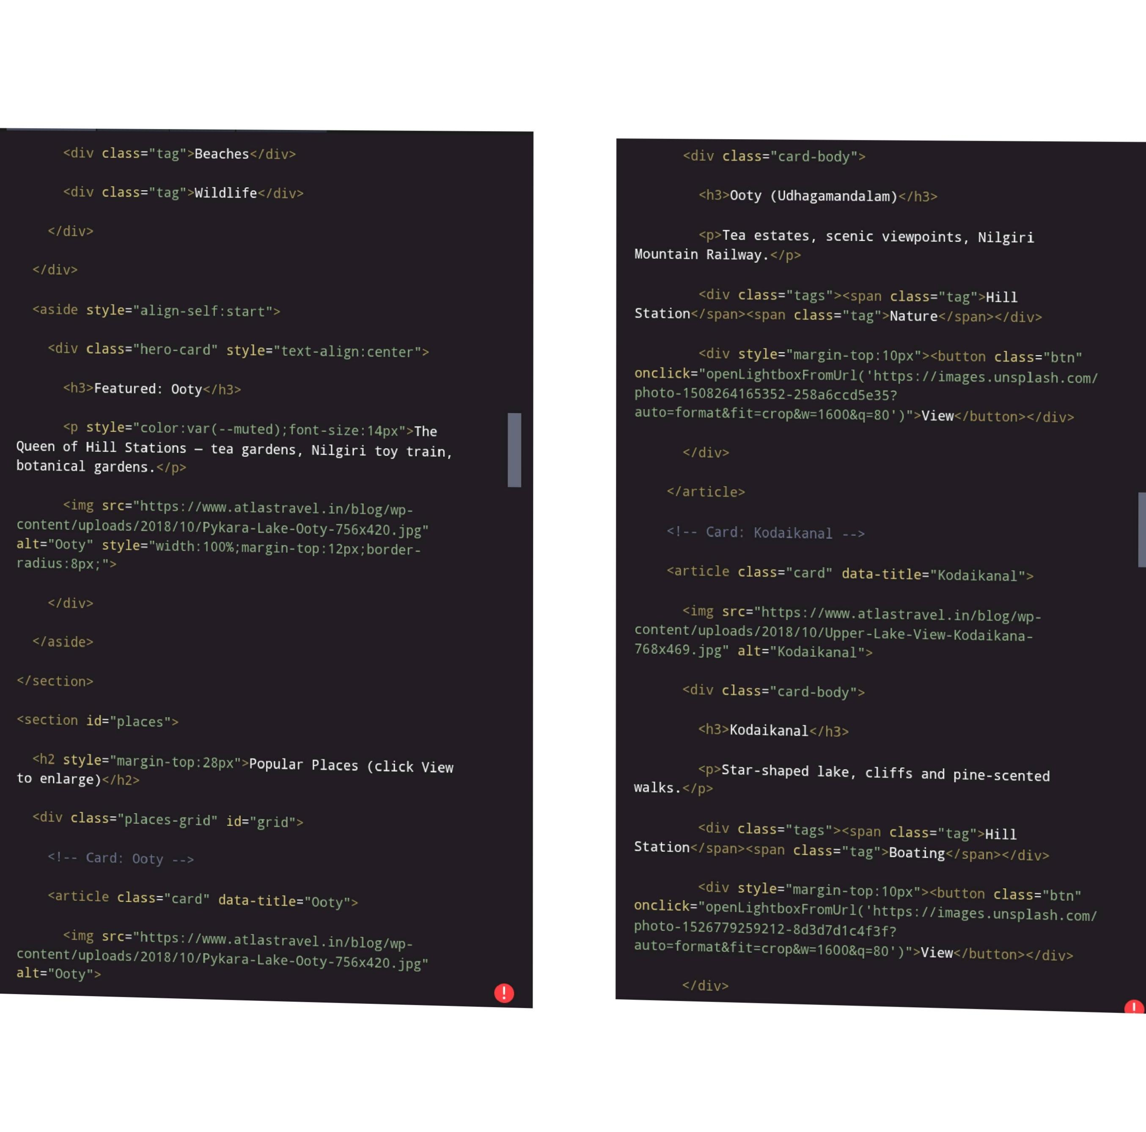

Slide 13
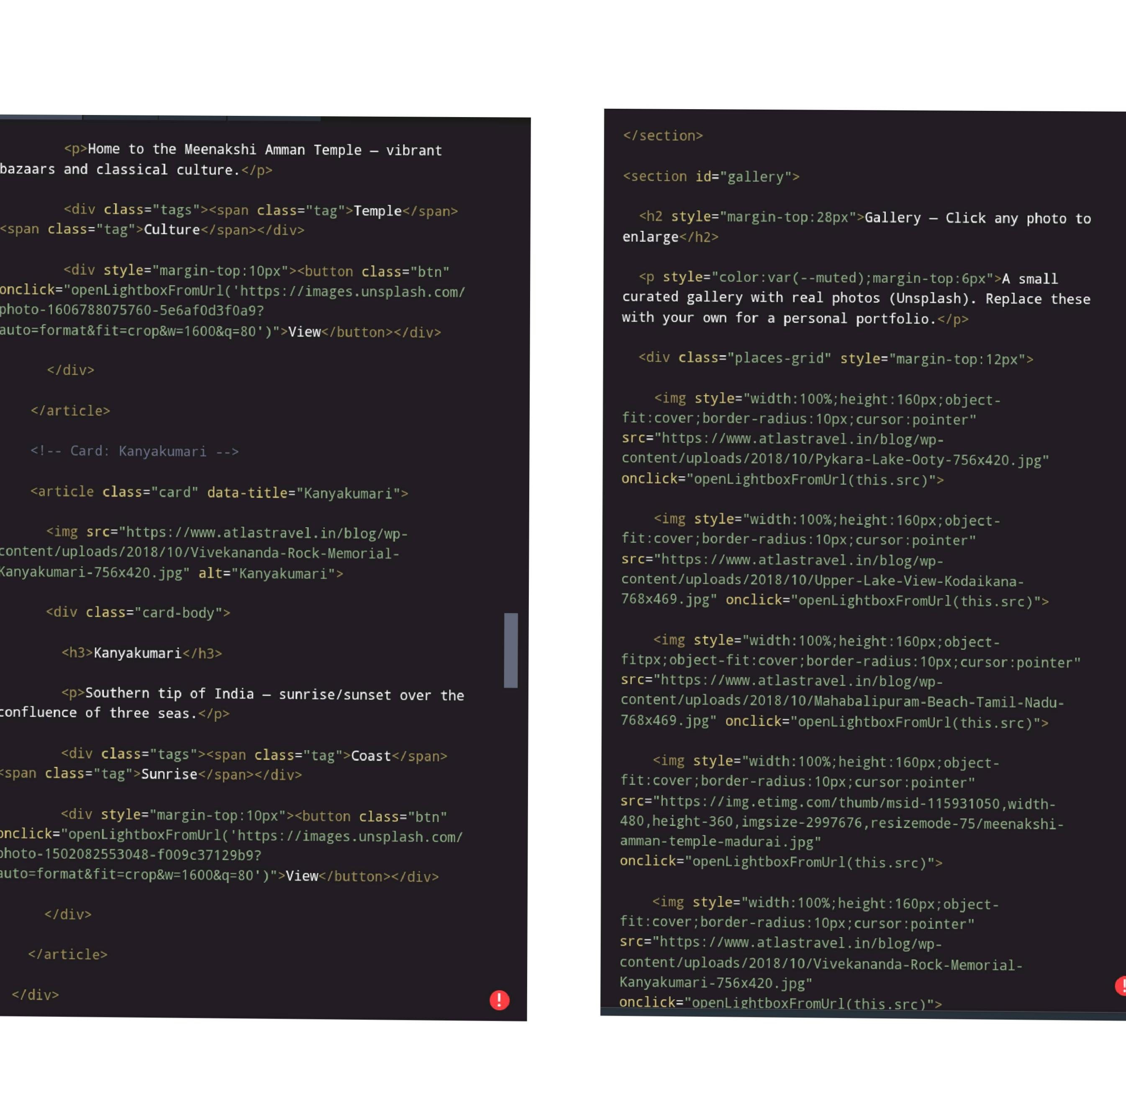

Slide 14
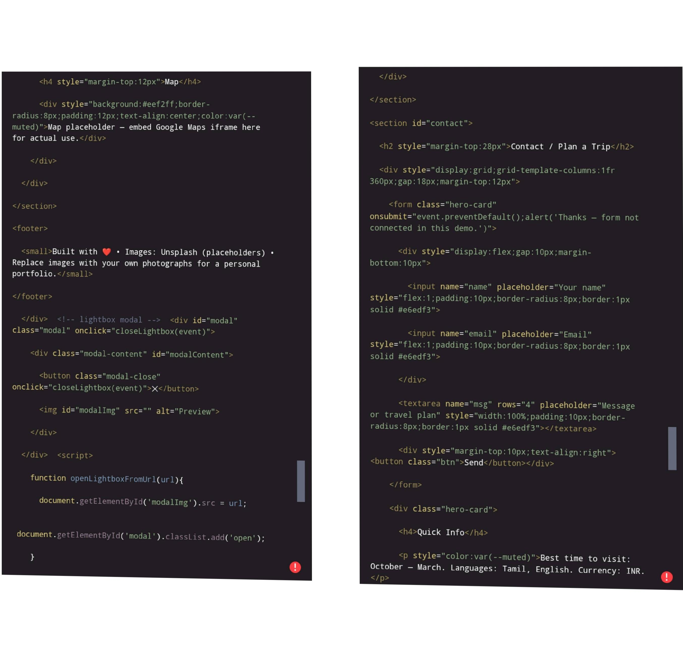

Slide 15
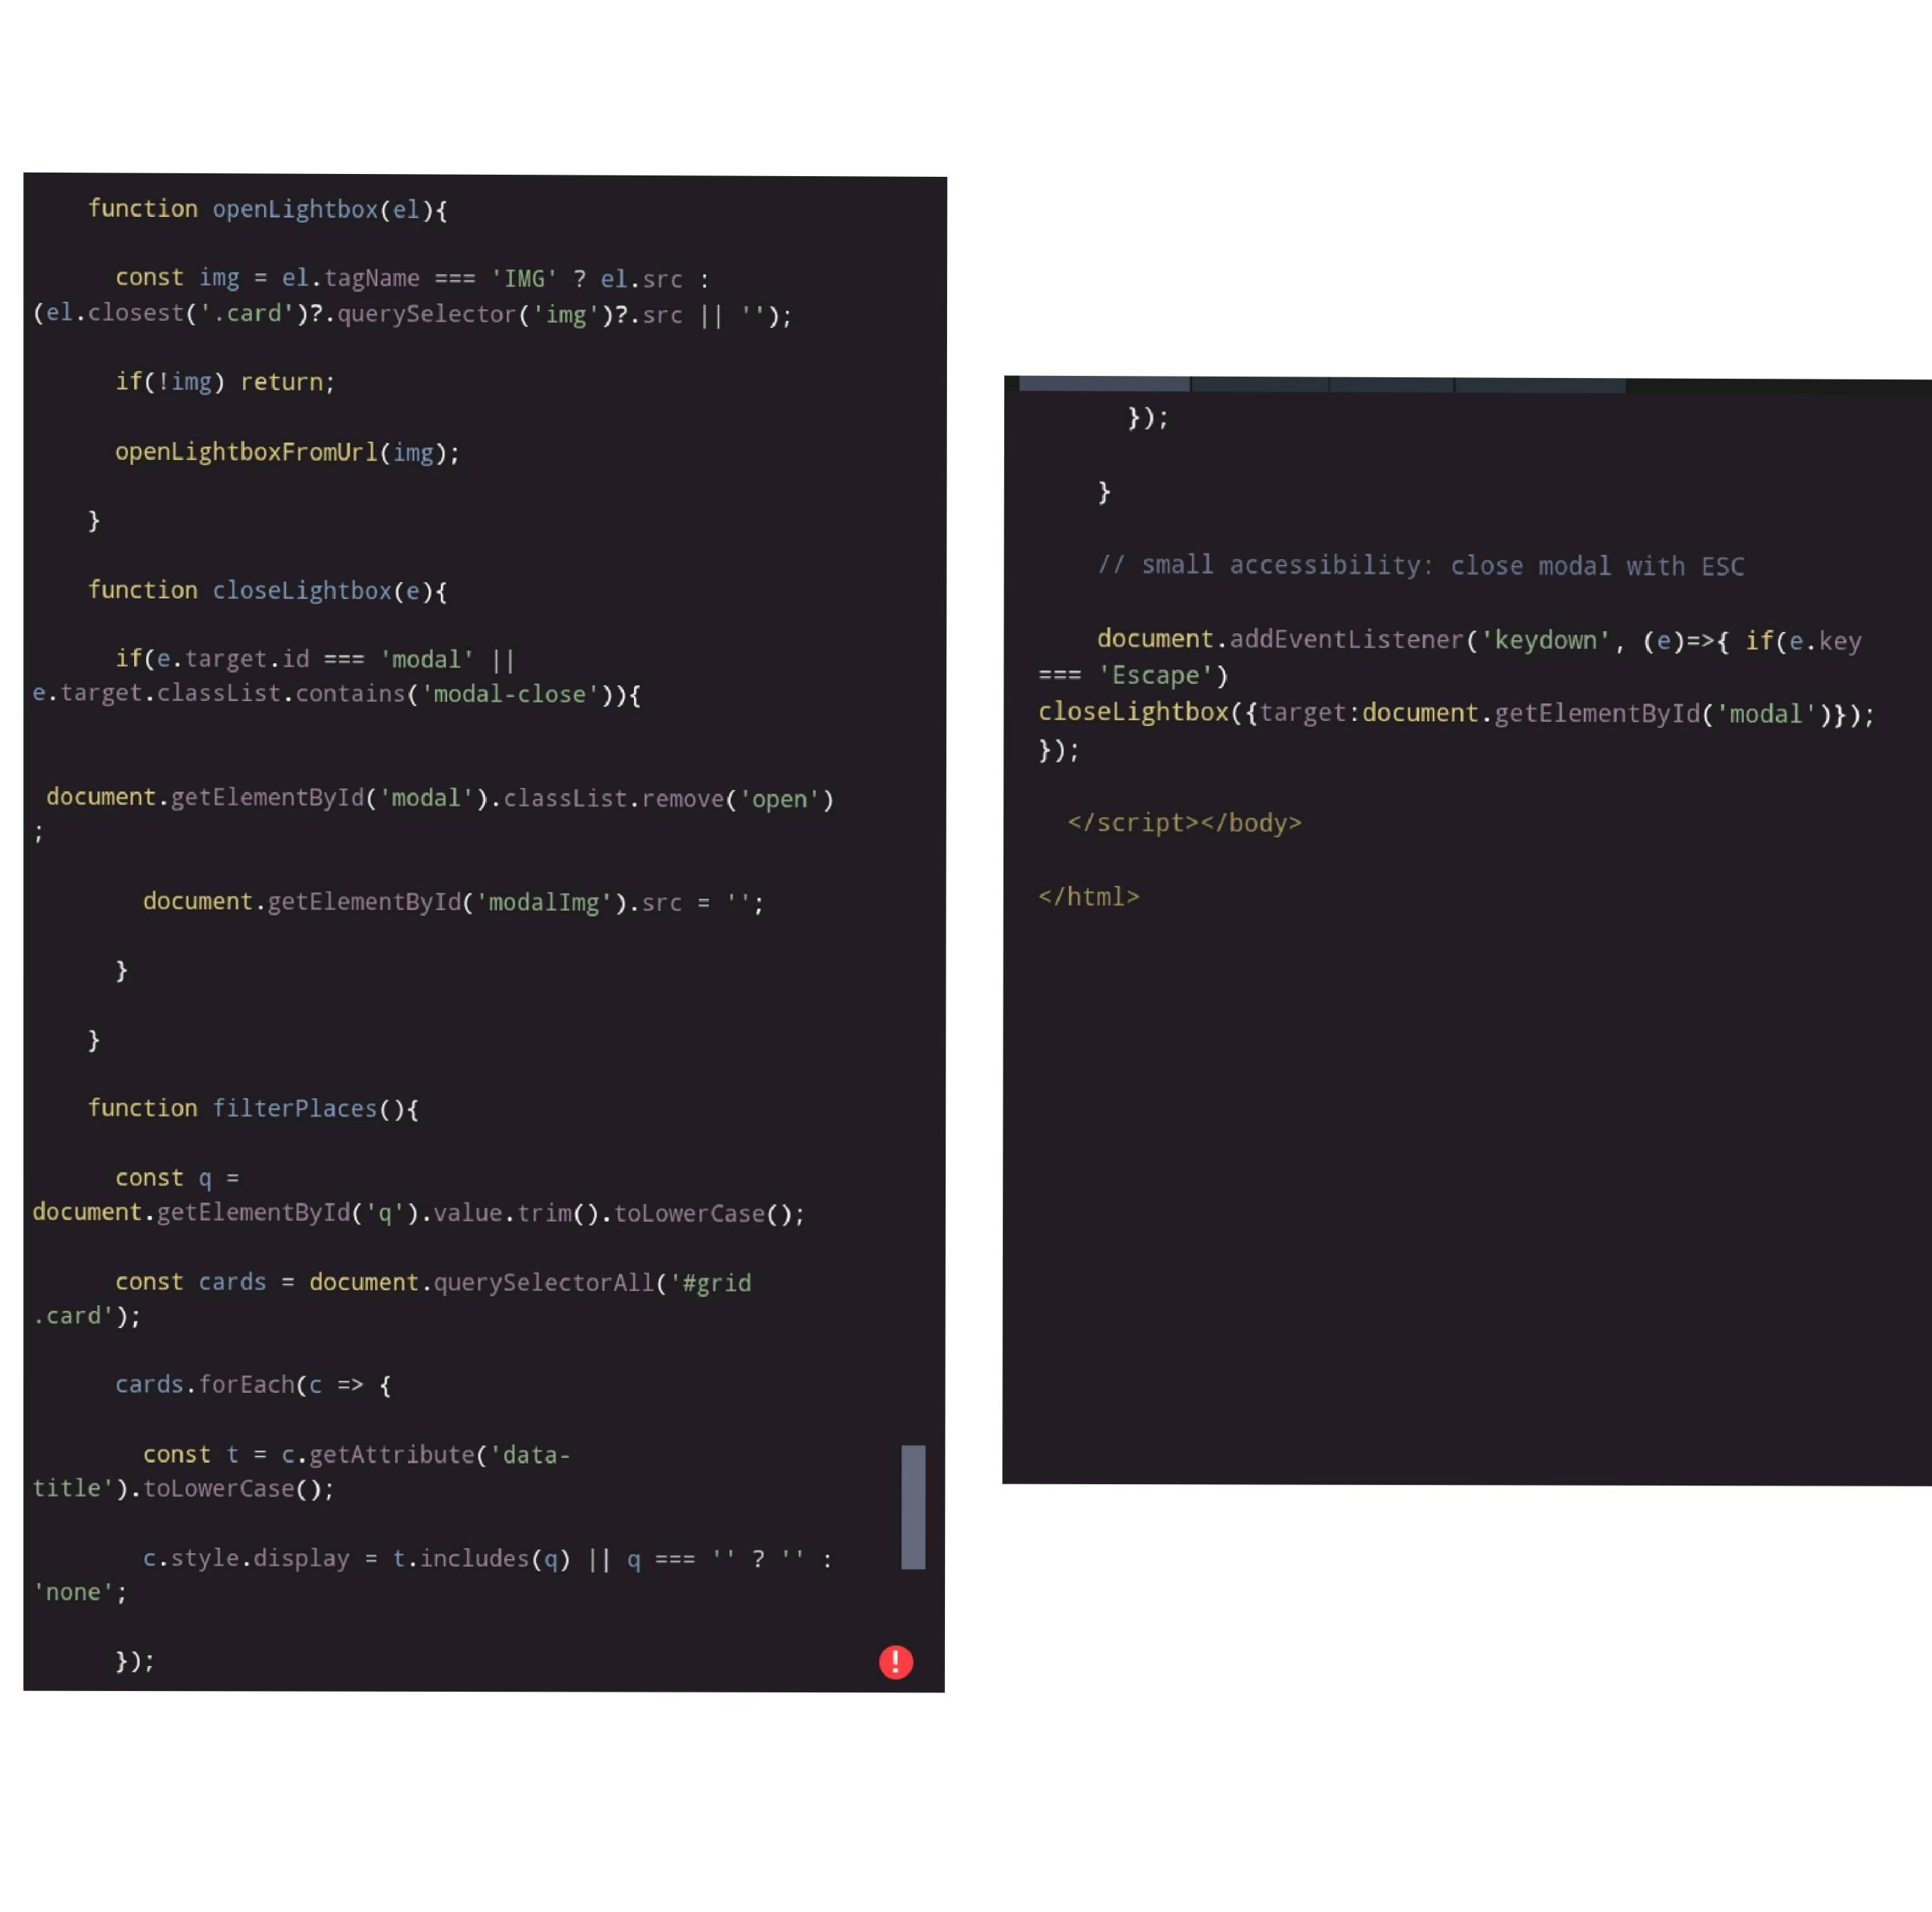

Slide 16
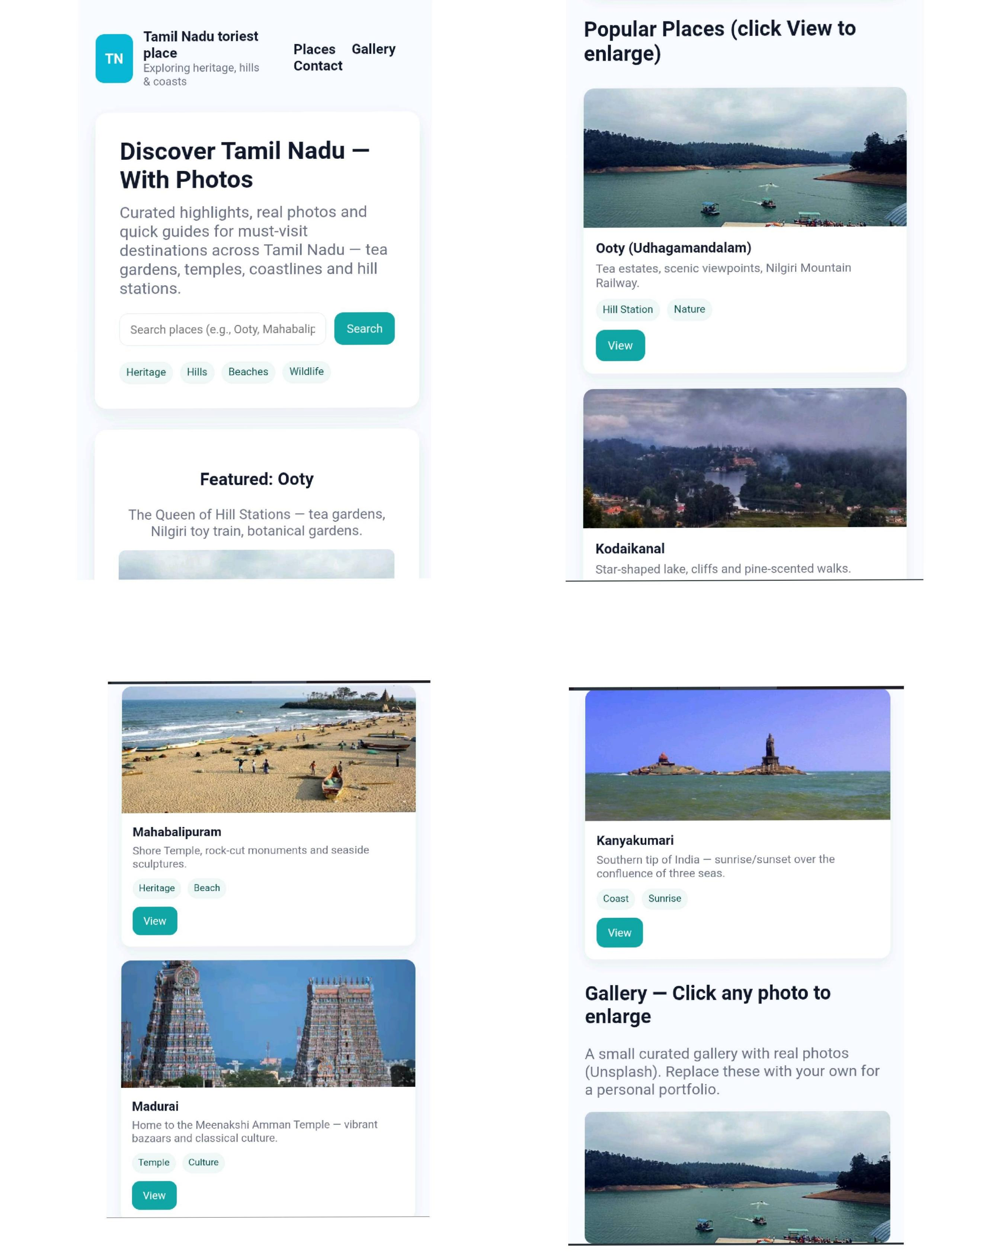
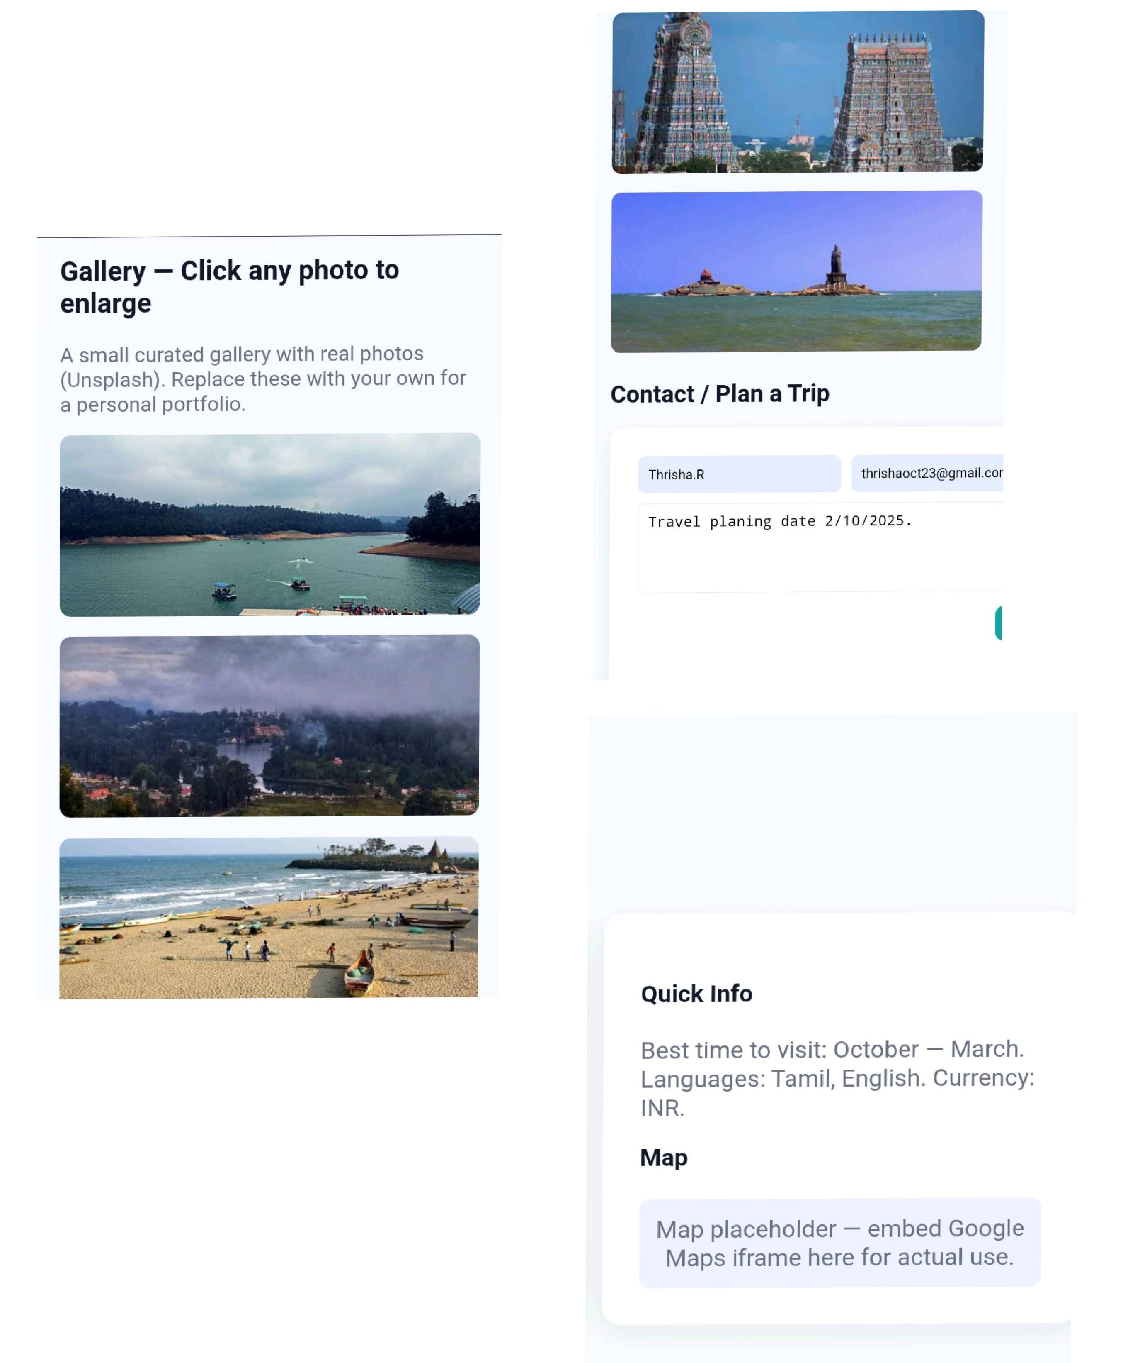
RESULT AND SCREENSHOT

Slide 17
CONCLUSION
The project successfully demonstrate a Digital portfolio for TamilNadu
Tourist places. It helps users get clear and quick information about
Destinations. The portfolio is simple, effective, and can be further
Improved by adding maps, images and booking features.
17

Slide 18
GITHUB LINK

